Slide 1
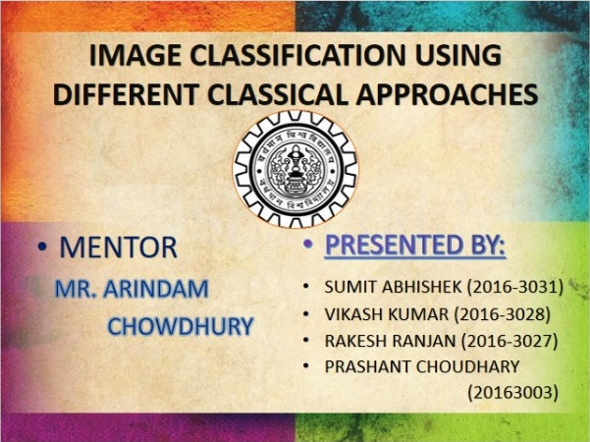

Slide 2
Content
Introduction
What is image classification?
Problem statement and understanding the data sets
Different Models Used (Algorithms)
K-nearest neighbors Algorithm
Random forest classification
Adaboost Algorithm
Support Vector Machine
Comparison between various algorithms
Future Scopes
Conclusion
References

Slide 3
Introduction
Image classification is a necessary step in pattern recognition, the efficiency and accuracy mainly depends on the classification.
The design and selection of classification method needs a careful attention to the following issues: definition of class, pattern representation, feature extraction, feature selection, selection of training and test samples and performance evaluation.
For classification of images we are going to use four algorithms which are k-nearest neighbours, Support vector machine, Random Forest and Adaptive boosting Algorithms.
Image Classification is an important task in various fieldssuch as biometry, remote sensing, and biomedical images.

Slide 4

WHAT IS IMAGE CLASSIFICATION?
Image classification refers to a process in computer vision that can classify an image according to its visual content.
In the Classification system database is very important that contains predefined sample patterns of object under consideration that compare with the test object to classify it appropriate class.
In a typical classification system image is captured by a camera and consequently processed.
In Supervised classification, first of all training took place through known group of pixels. The trained classifier used to classify other images.
The Unsupervised classification uses the properties of the pixels to group them and these groups are known as cluster and process is called clustering. The numbers of clusters are decided by users.

Slide 5
PROBLEM STATEMENT AND DATA SETS Problem statement: To study a retina image dataset and to model a classifier for predicting whether a person is suffering from glaucoma or not. The problem statement for a document classifier has two aspects: the document space and set of document class. The former defines the range of input documents and the latter defines the output that the classifier can produce. Here in our project, The document space is a database consisting of several numerical data sets of retinal image.
Data Sets: we have taken 255 retinal image data sets and performed our
classification operations on that image. We have used 70% of the image data set
for training our model and left 30% for testing the model.
The features are extracted from the fundus images using image processing
techniques - kurtosis, k-stat, mean, median, standard deviation and the obtained
numerical features are stored in a dataset.

Slide 6
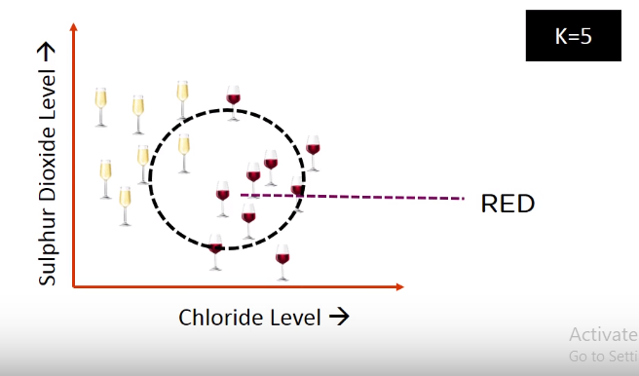
K- NEAREST NEIGHBOUR:
It is a simple algorithm that stores all availaible cases and classifies the new data or case based on a similarity measure.
A K in KNN is a parameter that refers to the number of nearest neighbours to include in the majority voting process.
It is very simple and intuitve

Slide 7
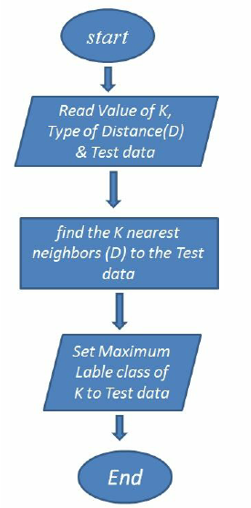
Algorithm for K-Nearest Neighbour:

Slide 8
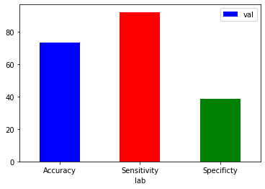
RESULT OF IMPLEMENTATION OF KNN ALGORITHM ON GLAUCOMA DATA SET :
We applied KNN algorithm on glaucoma data set consisting of 255 images and results we got are
True Positive(TP) = 162
False negative(FN) = 14
False positive(FP)= 59
True Negative(TN)= 37
Accuracy(%)= (TP+TN/N)*100
=73.1%
Specificity(%)=(TN/TN+FP )*100
=38.5%
Sensitivity(%)=(TP/TP+FN)*100
=92%

Slide 9
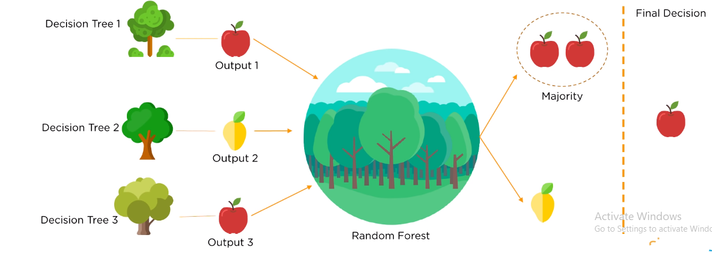
RANDOM FOREST CLASSIFICATION
Random Forest is a method that operates by constructing multiple decision trees during training phase
The decision of the majority of the trees is choosen by the random forest as the final decision.

Slide 10
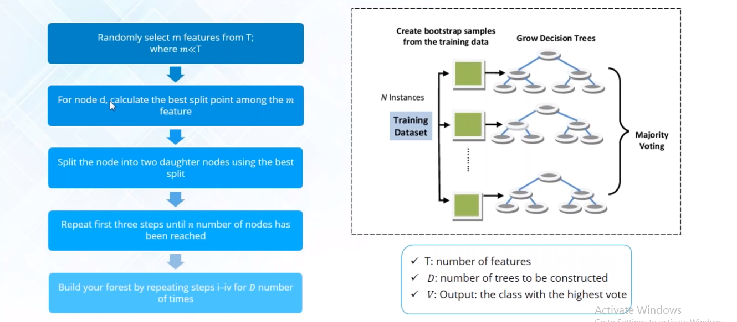
Random Forest Algorithm:

Slide 11
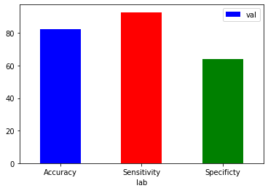
RESULT OF IMPLEMENTATION OF RANDOM FOREST ALGORITHM ON GLAUCOMA DATA SET :
We applied Random Forest algorithm on glaucoma data set consisting of 255 images and results we got are
True Positive(TP) = 106
False negative(FN)= 8
False positive(FP) = 24
True Negative(TN) = 43
Accuracy(%)= (TP+TN/N)*100
=82.3%
Specificity(%)=(TN/TN+FP)*100
=64.1%
Sensitivity(%)=(TP/TP+FN)*100
=92.9%

Slide 12
ADABOOST- Adaptive Boosting
It uses training set re-weighting
Each trainingsample uses a weight to determine the probability of being selected for a training set.
Adaboost is an algorithm for constructing a “strong” classifier as linear combination of “simple” “weak” classifier.
Final classification is based on weighted vote of weak classifiers.

Slide 13
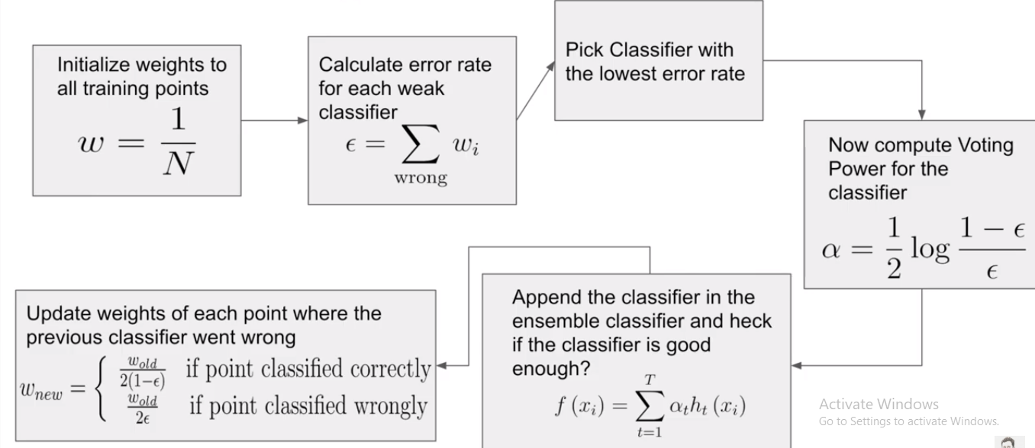
ADABOOST ALGORITHM

Slide 14
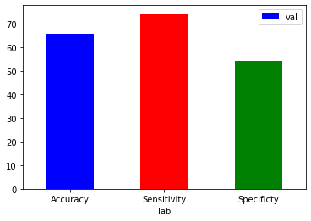
RESULT OF IMPLEMENTATION OF ADAPTIVE BOOSTING ALGORITHM ON GLAUCOMA DATA SET :
We applied Adaboost algorithm on glaucoma data set consisting of 255 images and results we got are
True Positive(TP) = 117
False negative(FN)= 41
False positive(FP) = 52
True Negative(TN)= 62
Accuracy(%)= (TP+TN/N)*100
= 65.8%
Specificity(%)=(TN/TN+FP)*100
=54.3%
Sensitivity(%)=(TP/TP+FN)*100
=74%

Slide 15
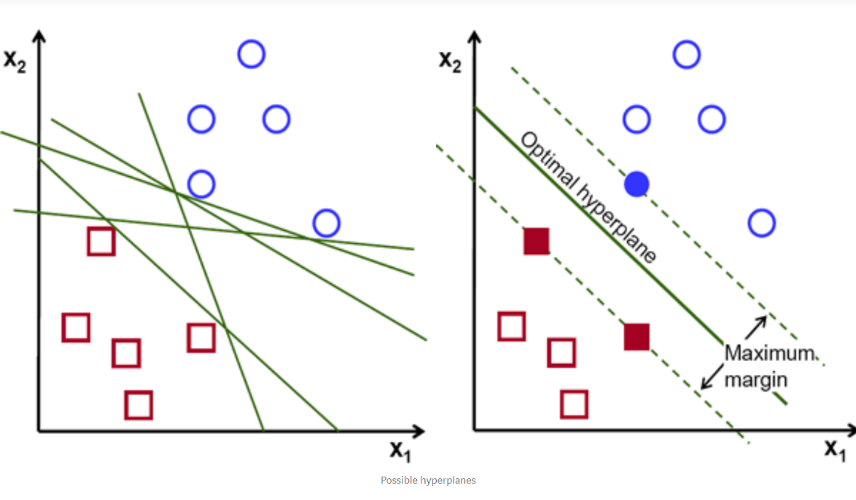
SUPPORT VECTOR MACHINE :
The objective of the support vector machine algorithm is to find a hyperplane in an N-dimensional space(N — the number of features) that distinctly classifies the data points.
To separate the two classes of data points, there are many possible hyperplanes that could be chosen. Our objective is to find a plane that has the maximum margin, i.e the maximum distance between data points of both classes. Maximizing the margin distance provides some reinforcement so that future data points can be classified with more confidence.

Slide 16
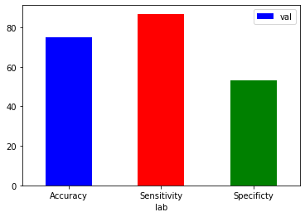
RESULT OF IMPLEMENTATION OF SUPPORT VECTOR MACHINE ALGORITHM ON GLAUCOMA DATA SET :
We applied Support Vector Machine Algorithm on glaucoma data set consisting of 255 images and results we got are
True Positive(TP)= 153
False negative(FN) = 23
False positive(FP)= 45
True Negative(TN) = 51
Accuracy(%)= (TP+TN/N)*100
= 75%
Specificity(%)=(TN/TN+FN)*100
=53.1%
Sensitivity(%)=(TP/TP+FN)*100
=86.9%

Slide 17
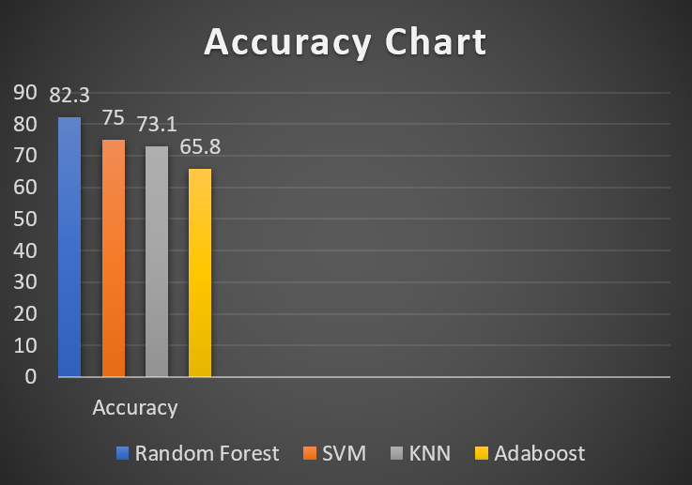
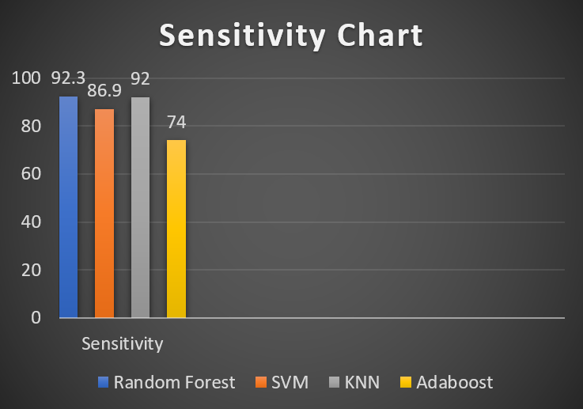
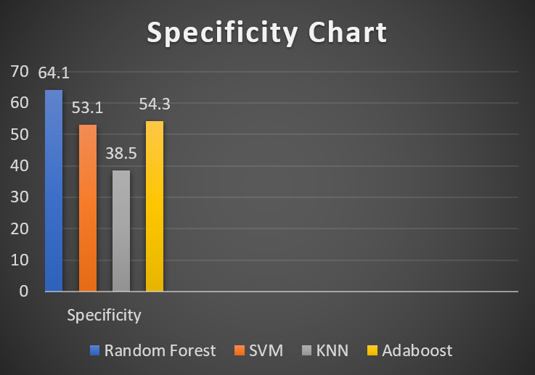
COMPARISON BETWEEN KNN,RANDOM FOREST,ADABOOST AND SVM ALGORITHMS

Slide 18
FURTHER IMPROVEMENTS AND FUTURE SCOPES
In our Glaucoma dataset, we achieved accuracy of 82.3% in finding the disease and in future we will increase the accuracy to higher extent .
We will use algorithms like Convolutional Neural Network, to increase the accuracy rate.
Currently we are using numerical data set as our input for
classification and we will directly take image data set as
input in future.
Advances in image processing and its classification will be helpful in diagnosing medical conditions correctly.
It will be helpful in recognizing people, performing surgery, reprograming, defects in humans DNA etc.

Slide 19
CONCLUSION
We applied four algorithms on our glaucoma dataset and
we found that random forest algorithm has highest
accuracy level of 82.3% in detecting glaucoma dieases .
Also we found that Random algorithm has highest
Specificity & Sensitivity value.
All this Algorithms can be used for better medical
diagnosis of diease like cancer, Eye diease etc.
It can also be used for biometric purposes such as
identity, face and finger print documentation.

Slide 20
References
Digital Image Processing: Kennth R.Castleman
https://grasswiki.osgeo.org/wiki/Image_classification
www.simplylearn.com
www.edureka.com
www.kaggle.com/dataset
http://www.ia.uned.es/~ejcarmona/DRIONS-DB.html
https://blog.keras.io/building-powerful-image-classification-models

Slide 21


Slide 22


